Slide 1
Advanced Regression Techniques for allocation of UN Financial Aid based on WHO Life Expectancy Data

Slide 2




Contents
Problem Definition
Machine Learning
Results & Recommendation
EDA

Slide 3

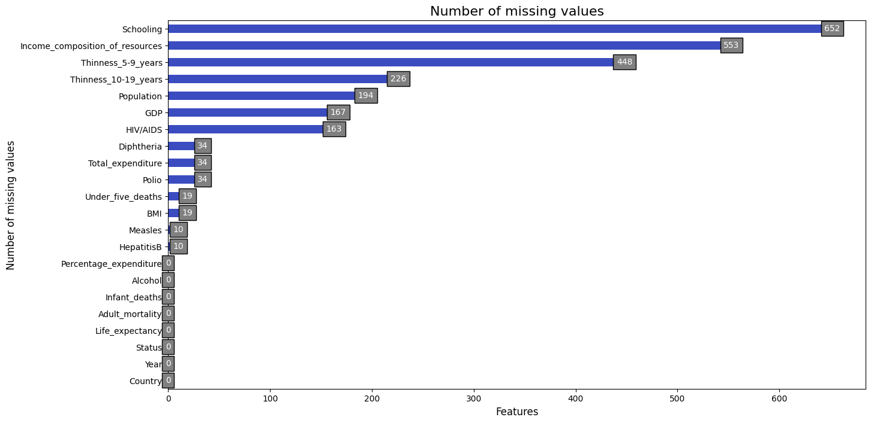
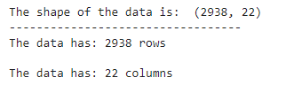
Data
Life Expectancy Dataset (WHO) :
(https://www.kaggle.com/datasets/kumarajarshi/life-expectancy-who/code?datasetId=12603&sortBy=voteCount
Null Value imputation strategy:
Median

Slide 4
EDA

Slide 5
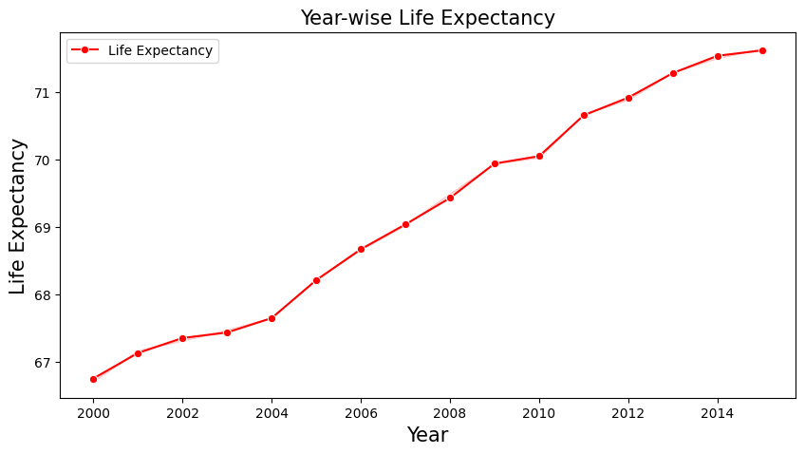
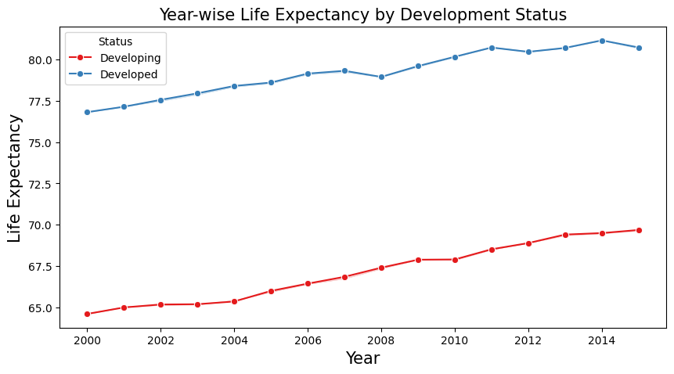
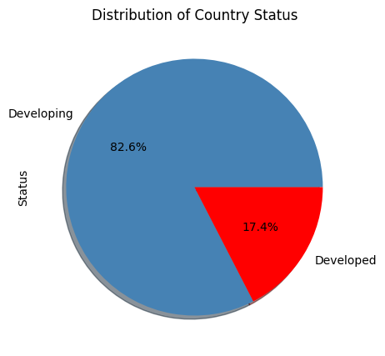
Life Expectancy over the years 2000-2015

Slide 6
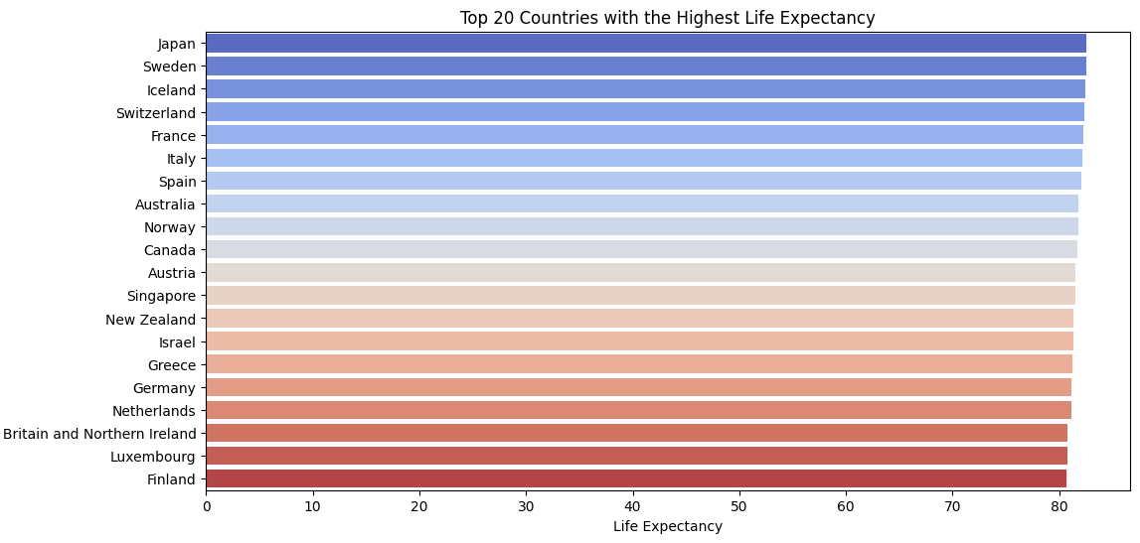
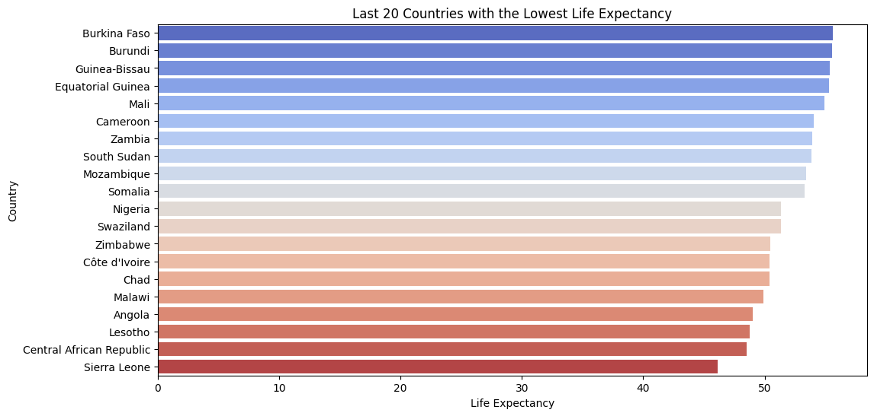
Countries with the Lowest and Highest life expectancies

Slide 7
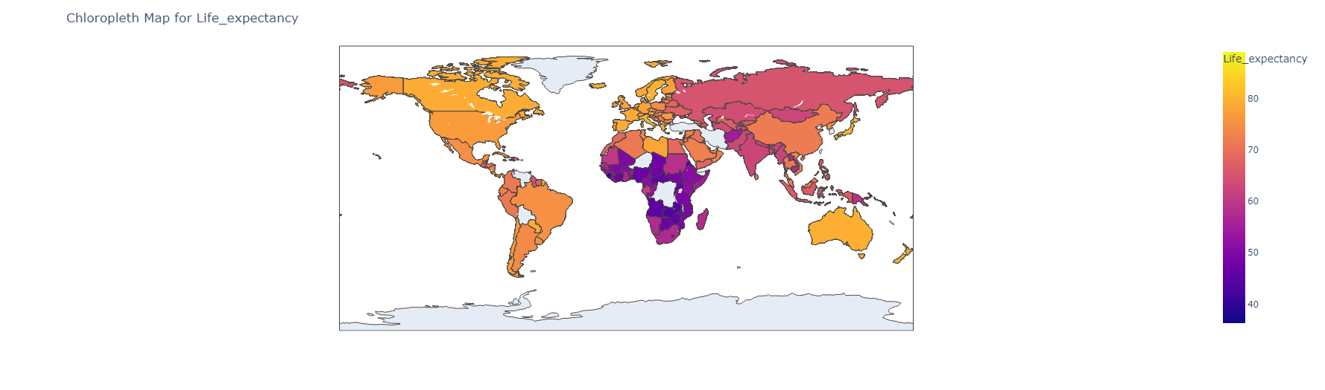
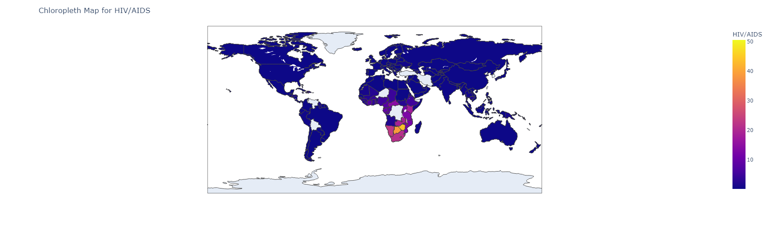
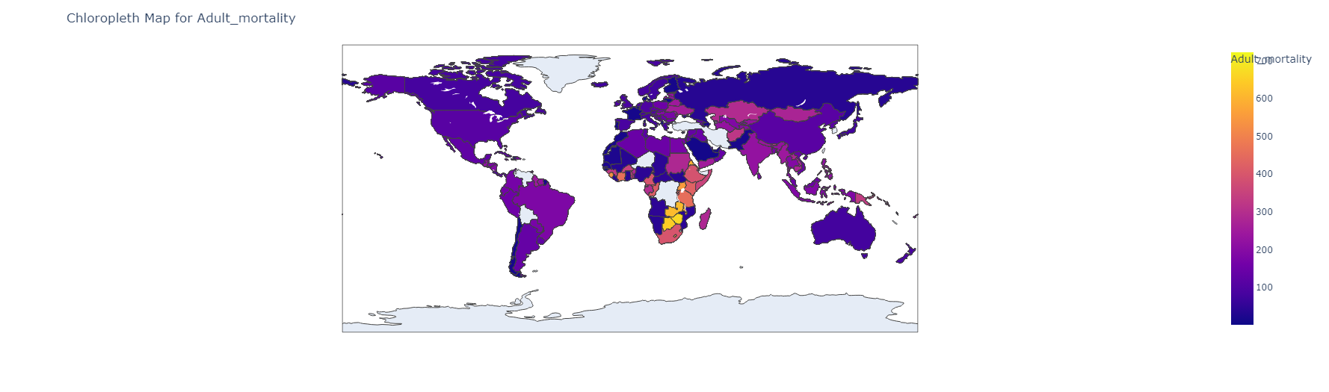
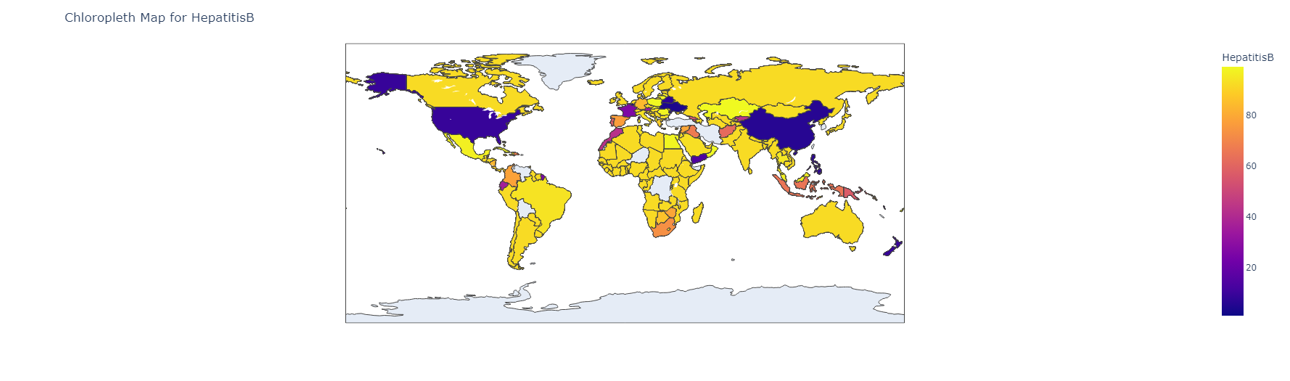
Chloropleth Map Distributions
Life Expectancy
HIV AIDS
Adult Mortality
Hepatitis B

Slide 8
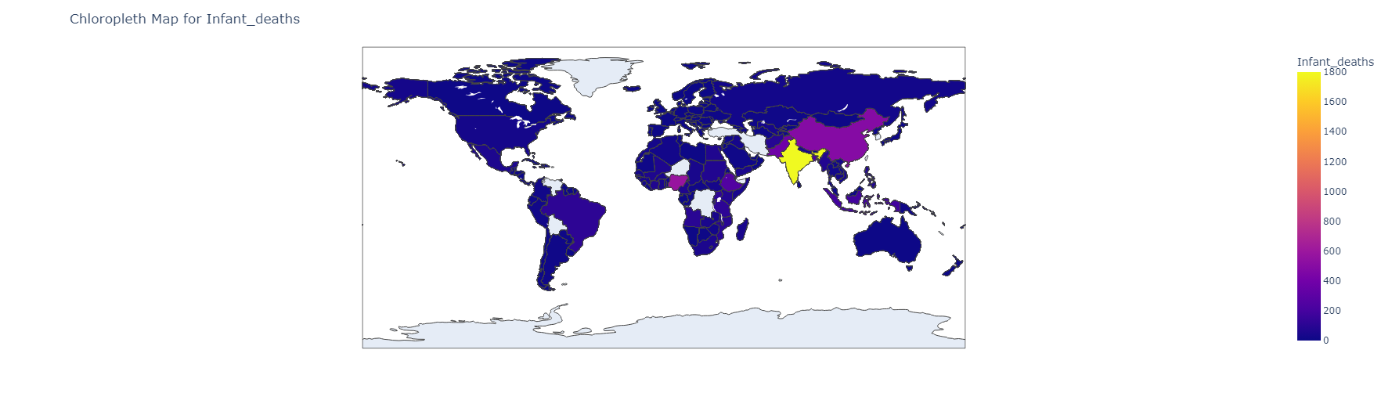
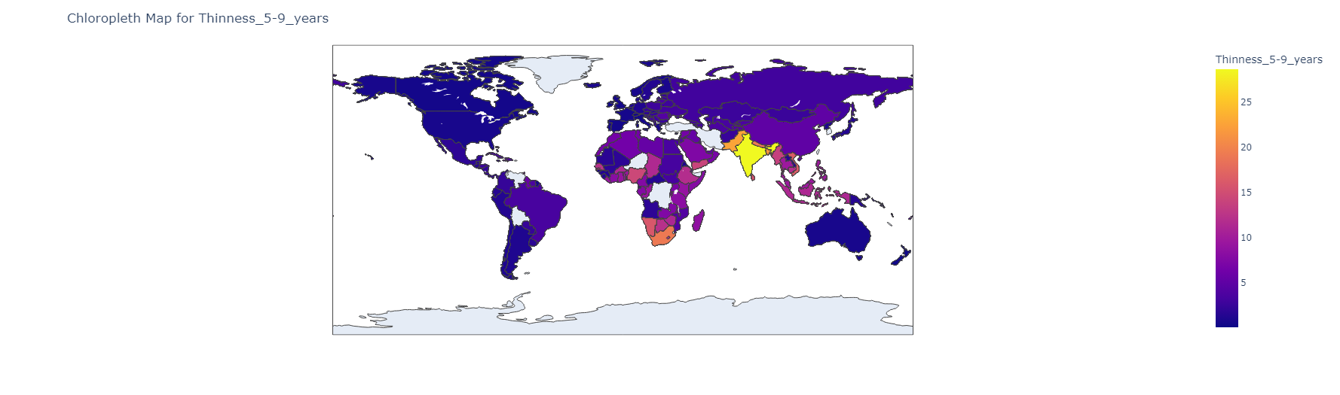
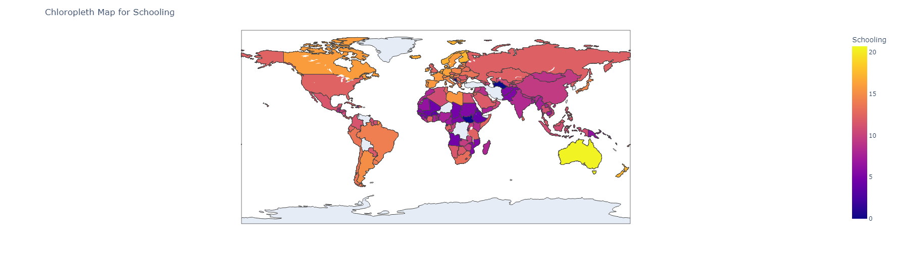
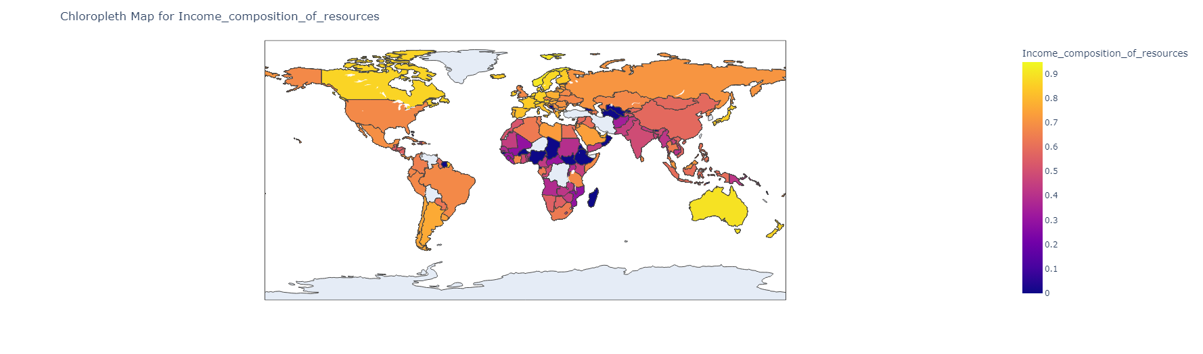
Chloropleth Map Distributions
Infant Deaths
Thinness 5-9 years
Schooling
Income Composition

Slide 9
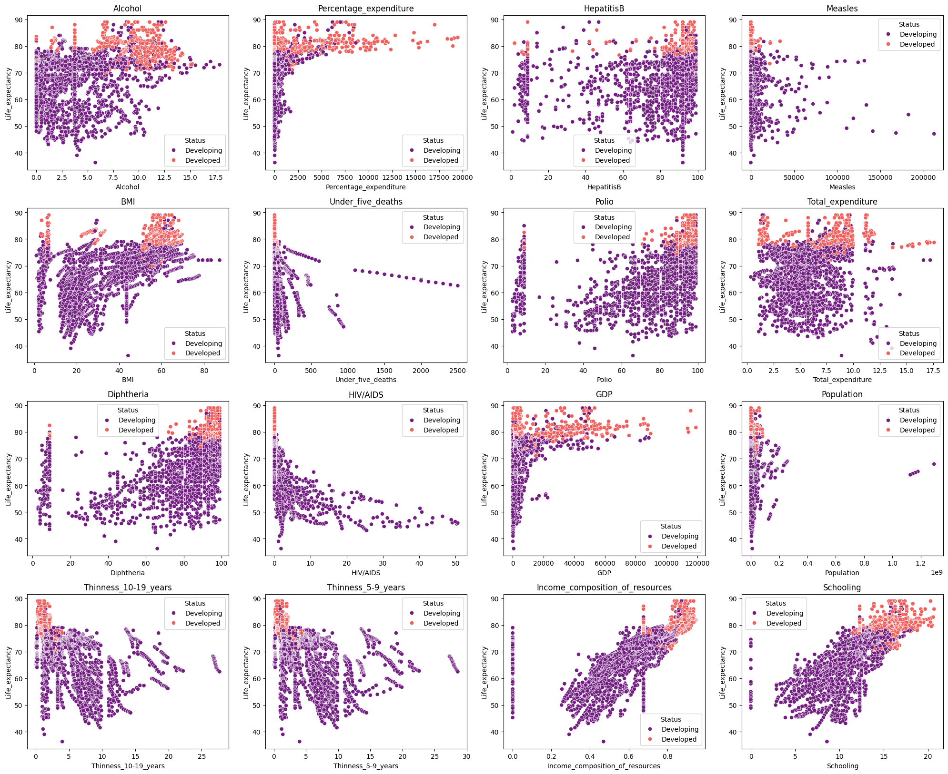
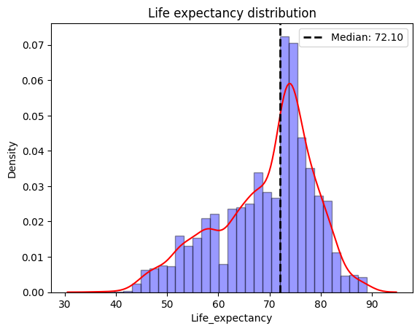
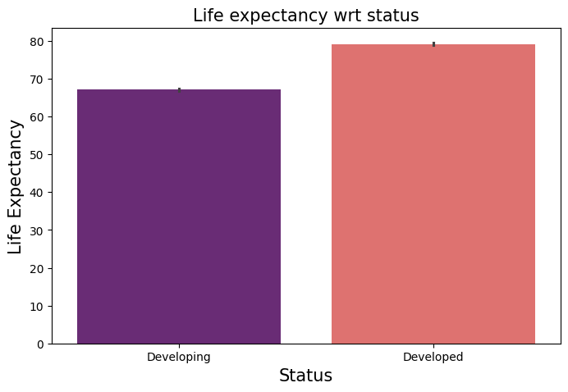
Scatter Plots of variables wrt development status
Developed countries display a higher life expectancy for all the features.

Slide 10
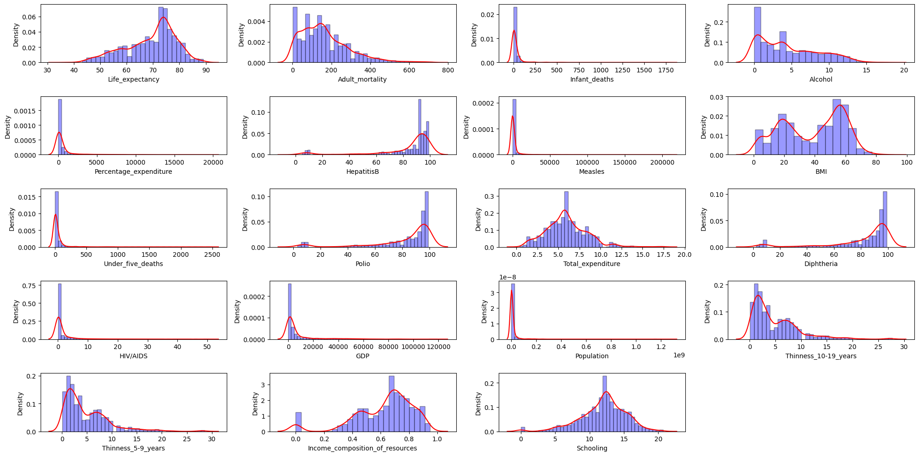
Kernel Density Distribution Plots
The KDE plots of the Features are either right-skewed or Left-skewed and have different scales.

Slide 11
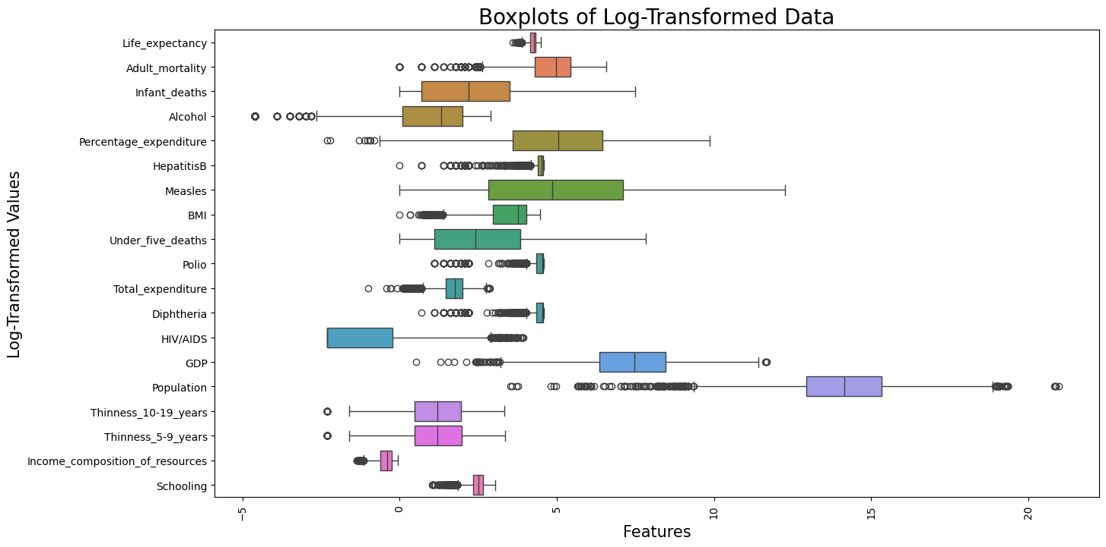
First Log Transformation
All the features have been scaled between the range -5 and 20 after first Log transformation.
Data scaled between -5 and 20

Slide 12
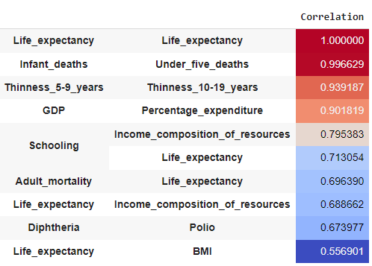
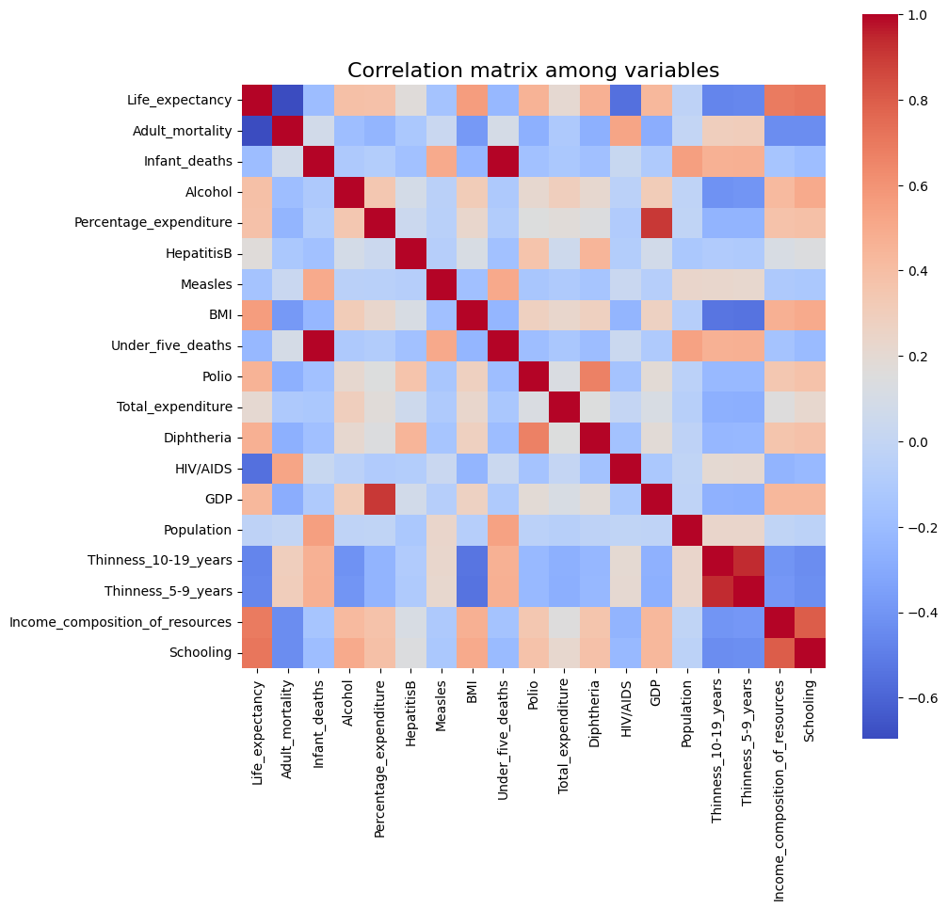
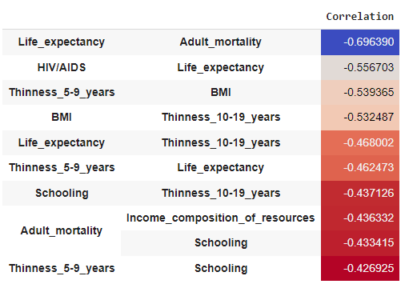
Correlations Heatmap

Slide 13
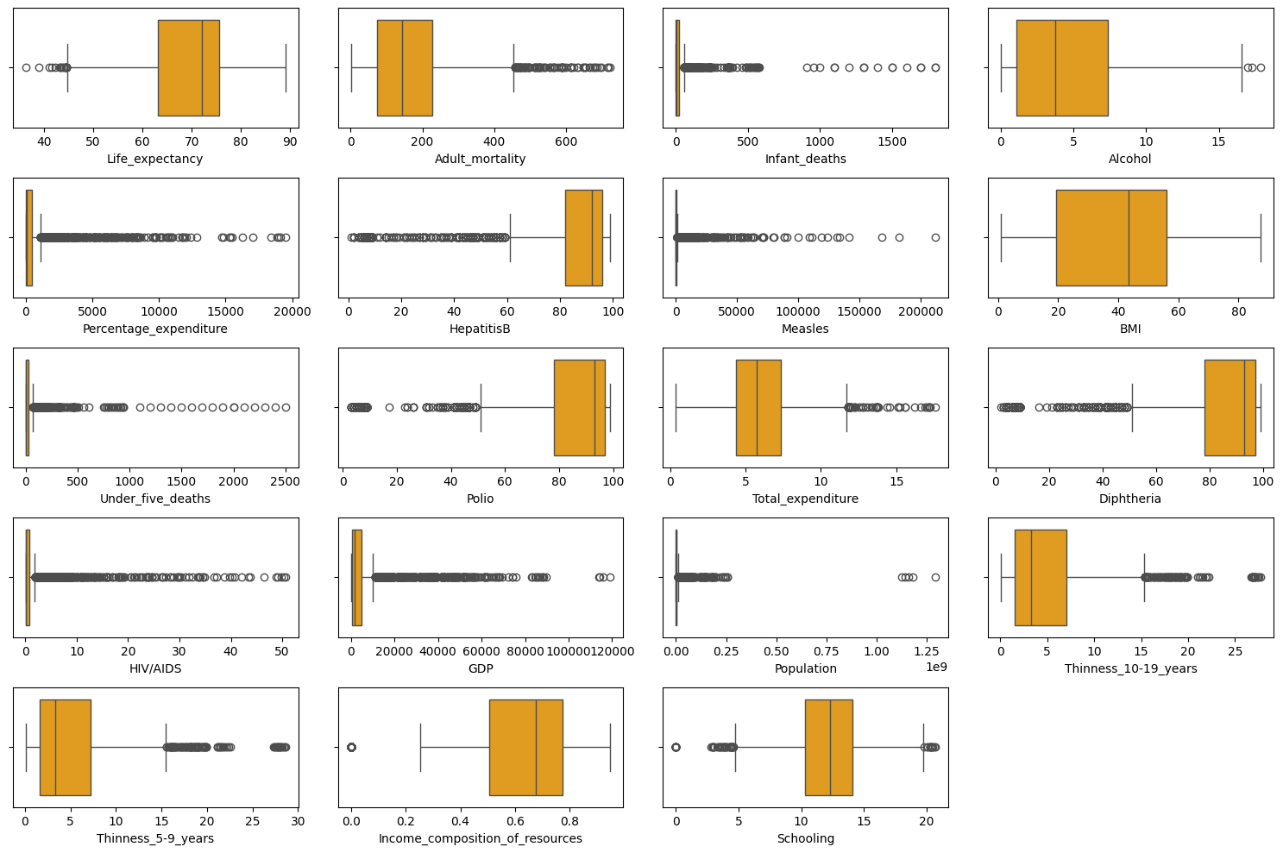
Box Plots for Outlier Visualization
The Box plots for the features show that each of the outliers have a large number of outliers with varying scales.

Slide 14
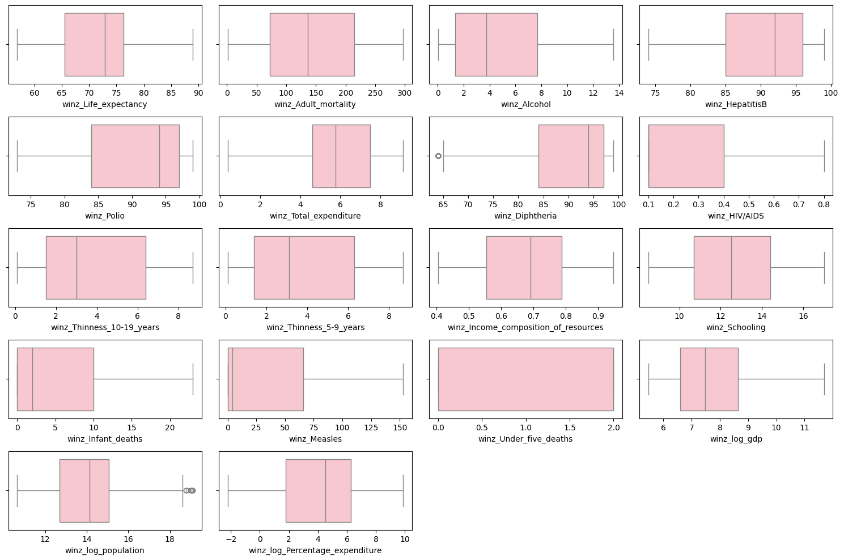
Winsorization method for outlier removal
In winsorization, extreme values are replaced with values closer to the rest of the data.
Points below 5th percentile → 5th Percentile.
Points above 95th percentile → 95th Percentile.

Slide 15
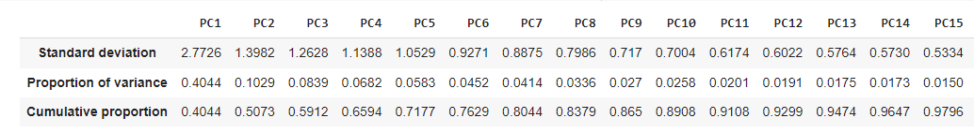
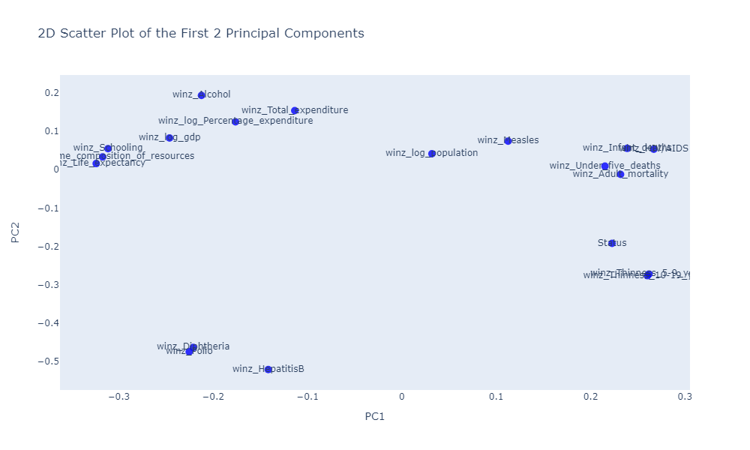
PCA for Dimensionality Reduction
n_components =15
2D Scatter Plot with PC1 and PC2
Proportion of Variance diminishes after PC15. These 15 components explain upto 97% of the total cumulative variance in the data.

Slide 16
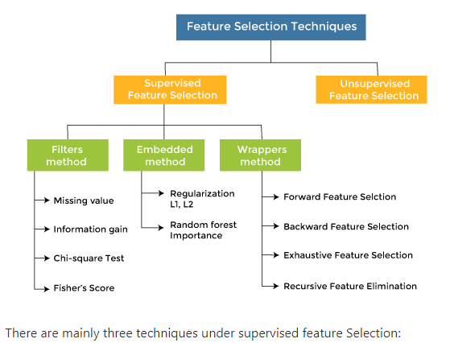
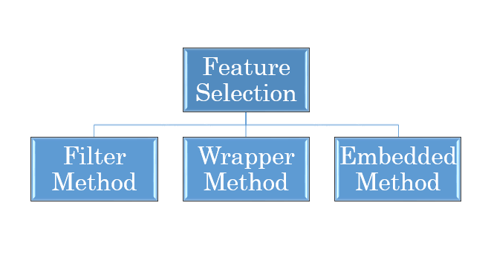
Feature Selection Techniques

Slide 17
Machine Learning

Slide 18
Modeling
DATA SPLITTING
- Training set: 80% - Test set: 20%
MODEL TRAINING
PCA +Linear Regression
Ridge Regression
Lasso Regression
MODEL EVALUATION
R^2, MAE, MSE, RMSE

Slide 19
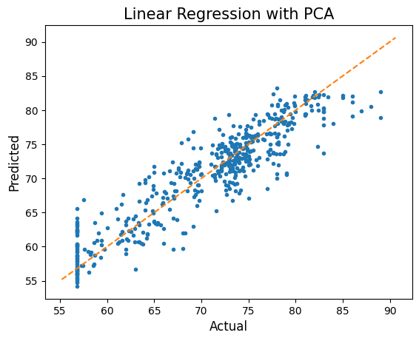
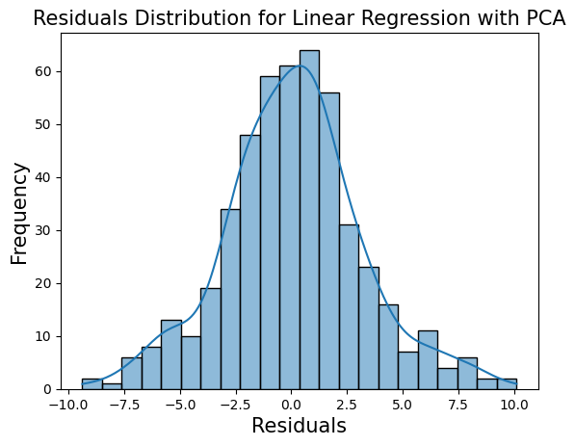
PCA with Linear Regression
R squared = 84.10 %

Slide 20
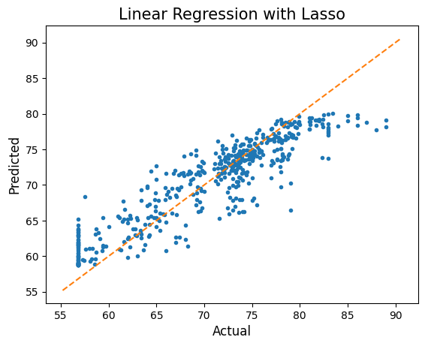
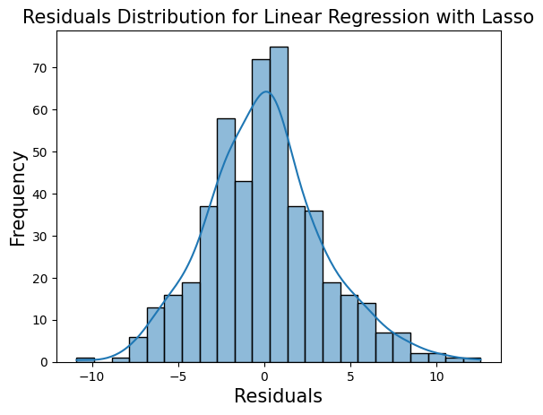
Linear Regression with Lasso
R squared = 80.81 %

Slide 21
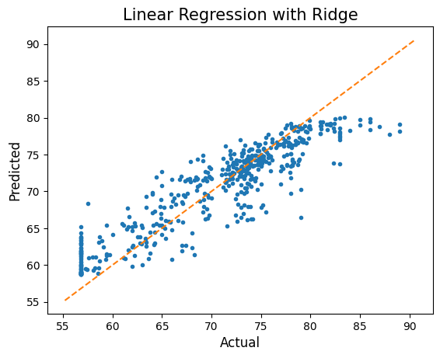
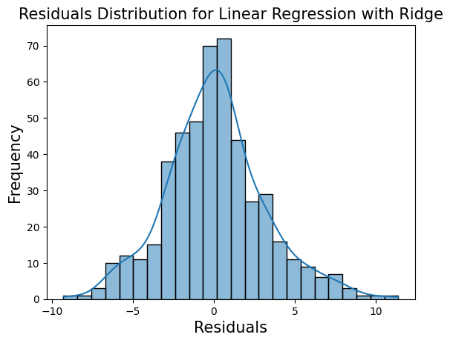
Linear Regression with Ridge
R squared = 84.52 %

Slide 22
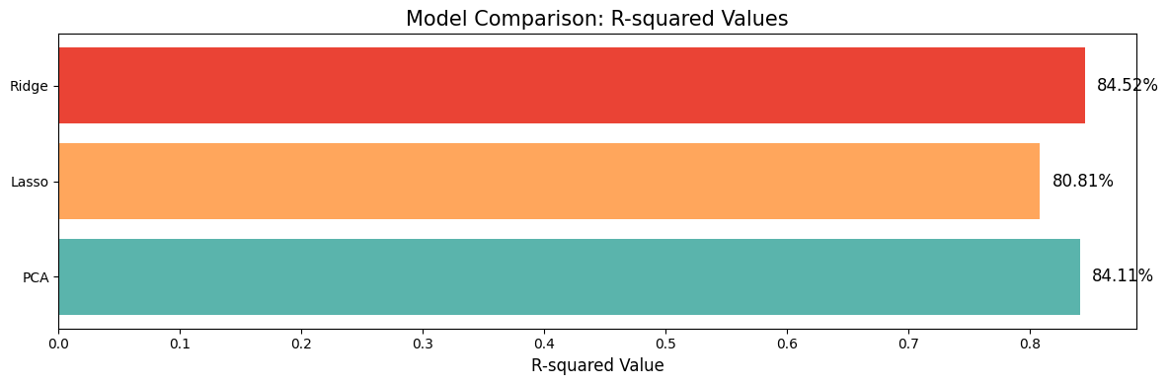
Model Comparison
Best Model -- Ridge Regression R squared = 84.52 %
Ridge regression was able to select the appropriate number of features required to explain the variability of the model in contrast to Lasso which reduced most of the variables to zero.

Slide 23
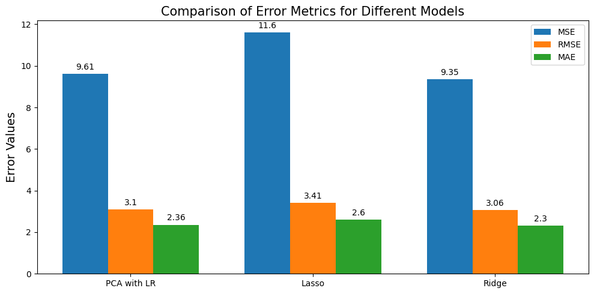
Model Comparison -- Error Metrics

Slide 24
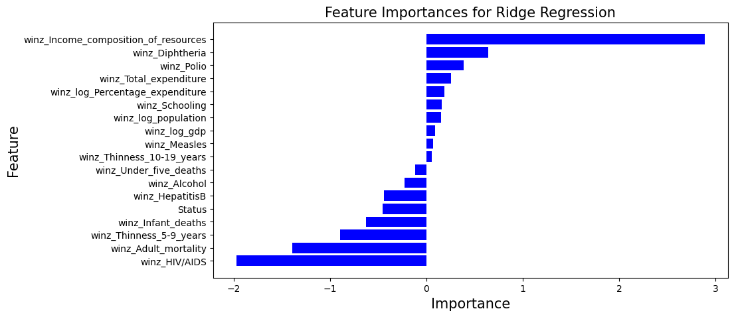
Feature Importances
Positive effect on life expectancy
Negative Effect on life expectancy

Slide 25
Recommendations and Conclusion
According to the Ridge regression model, the following features have a negative effect on life expectancy. Higher value of these features will result in higher Financial Aid.
HIV AIDS
Adult Mortality
Thinness of Children aged 5-9 years
Infant Deaths
Status of the country -- Developed vs Developing
Hepatitis B
Alcoholism
Under 5 deaths

Slide 26
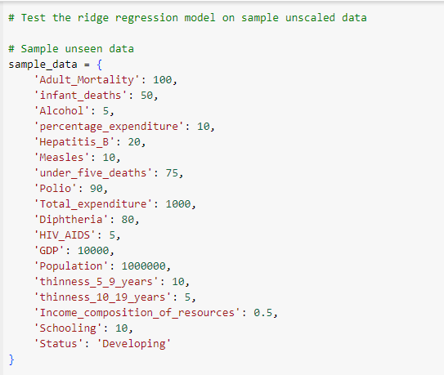
Model Testing on Sample Unseen Data
Financial Aid : Moderate

Slide 27

Questions?

Slide 28

Thank You!

Slide 29

Appendix

Slide 30
